Slide 1

Basketball in the Bubble
An Exploratory Look into the 2020 NBA Post Season
By Alek Sanchez

Slide 2

What was “The Bubble”
Notes:
The Bubble is the nickname of the 2020 NBA Playoffs, which took place in an isolated environment, inside the Disneyworld Campus in Florida. No fans allowed, no guests until the start of the Semi Conference Round, no access to leaving the campus while players were actively playing. Some fans believed it to be “the purest form of basketball ever played”, due to these circumstances.
My Data was collected from the online database, Basketball-Reference, using an API. I collected data from the 2020 Regular and Post Season, as well as the 2019 Regular and Post Season.

Slide 3
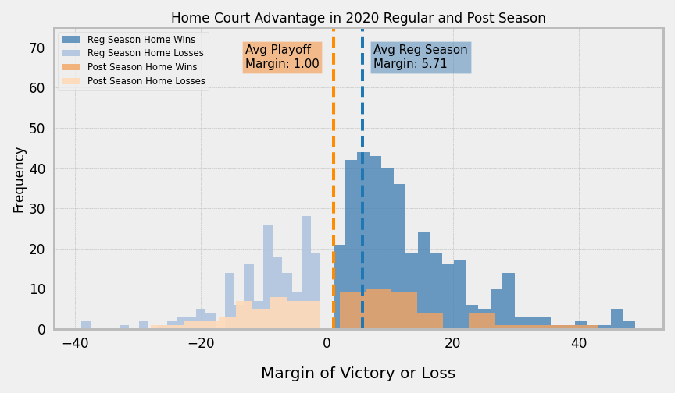
H0: Margin of Victory in Home Games is the same in the Bubble as on the outside
Notes:
If any of you are familiar with the Golden State Warriors, you may have heard of their old Oakland stadium, nicknamed “R-Oracle” for how deafening it can be in there. Home Court Advantage may be a real thing. I examined the average margin of victory in Home Games, during and before the Bubble. Though graphically, the Bubble statistic seems that Home Court Advantage was more neutral, or closer to 0, after performing a Student’s T-Test, I fail to reject the Null Hypothesis.

Slide 4
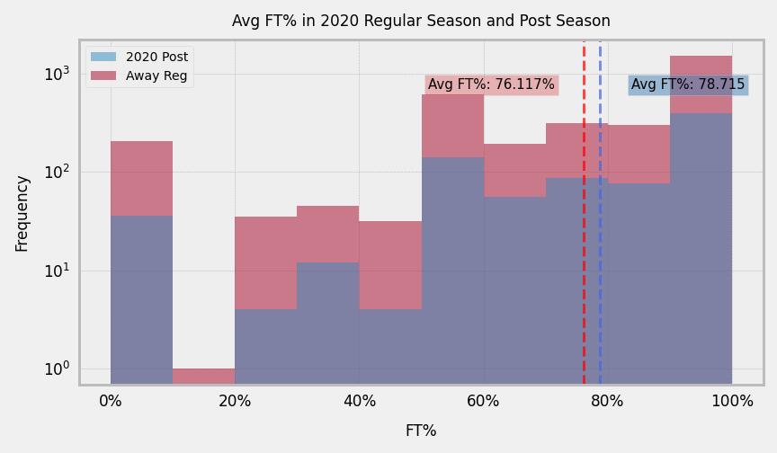
H0: Average FT% inside the Bubble is the same as on the outside
Notes:
For those of you who may not know, a Free Throw Line is a standing shot taken a certain amount of distance away from the rim, with no opposing players guarding them, hence the name ‘Free’ Throw. Without the deafening noise of the crowd to distract players at the Free Throw line, I wanted to see if the average FT% inside the bubble differed from the average FT% of Regular Season Games, in opposing arenas (aka the crowds more likely to boo the player shooting the FT).
Though I did observe an increase in average FT% within the bubble compared to outside of it, after performing a Student’s T-Test, I fail to reject the null hypothesis.

Slide 5
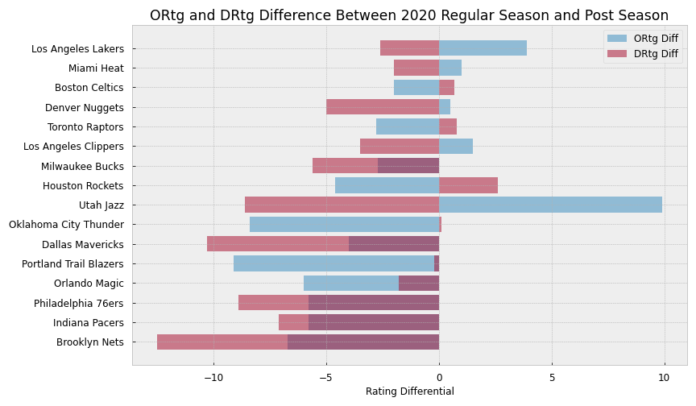
H0: ORtg and DRtg are the same in the Bubble as outside
Notes:
In a contained environment such as the bubble, players are not expected to travel, which led me to think that their conditioning, or ability to play and hustle harder, would be different in the Bubble. Two stats help encapsulate a team’s Offense and Defensive abilities, their Offensive Rating and Defensive Rating. ORtg is a measure of how much a team scores, and DRtg is a measure of how many points they allow to be scored on them. A drop in DRtg means that a team allowed more points to be scored on them in the Playoffs, than in the Regular Season.
After performing a Mann-Whitney U test for the ORtg from the Bubble and the Regular season, I fail to reject the null hypothesis.
In the case of the DRtg, I reject the null hypothesis. Practically, this may be because if teams are working harder on defense, it may be stifling the opponent’s offense, leading to a similar ORtg in the Bubble as outside.

Slide 6
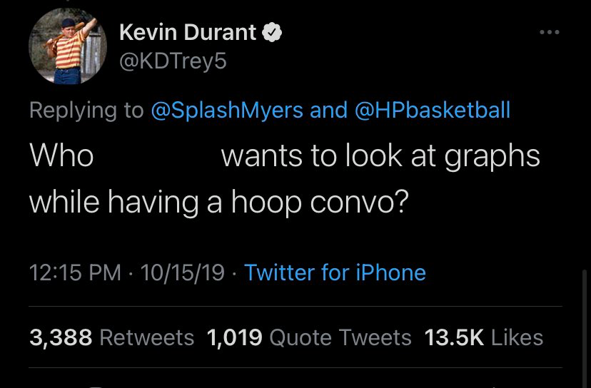
In Conclusion
Notes:
In conclusion, through the tests that I designed, most did not signify a statistical significance. For future analysis, I would want to expand my data set to include more seasons. I would also like to have performed some sort of analysis that tied all my tests together, something related to the margin of victory, and shot attempts, and pace of play.
There are some basketball fans who prefer to evaluate with the “eye-test”, rather than look at advanced metrics or graphs. The Bubble provided some of the most exciting basketball moments in recent years, whether or not it was statistically significant.

Slide 7
Any Questions?

Slide 8
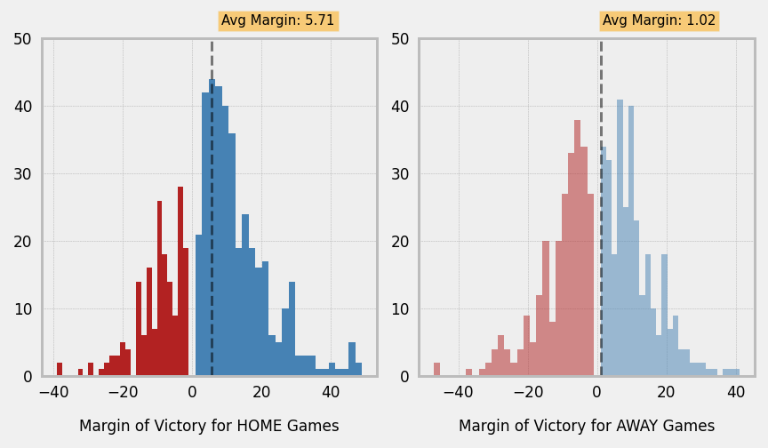
Appendix 1: Margin of Victory for Playoff Teams in 2020 Regular Season

Slide 9
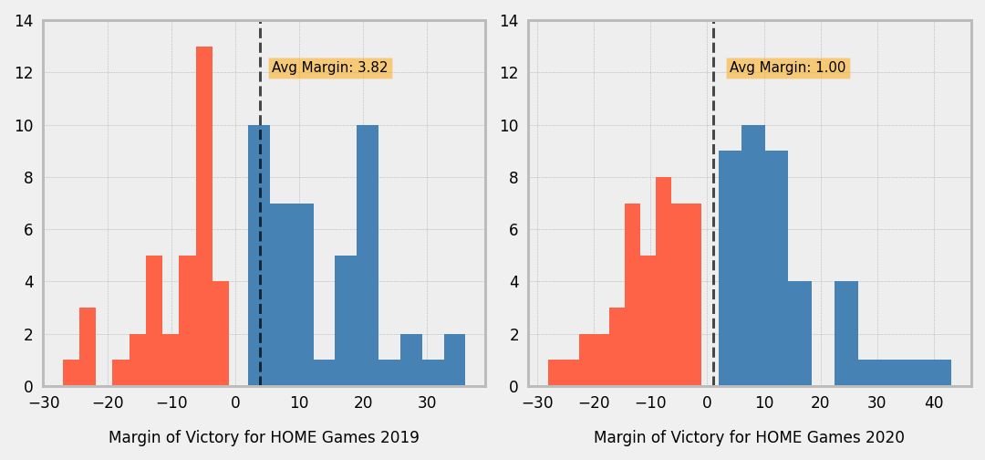
Appendix 2: MoV for HOME Games, 2019 Post Season and 2020 Post Season

Slide 10
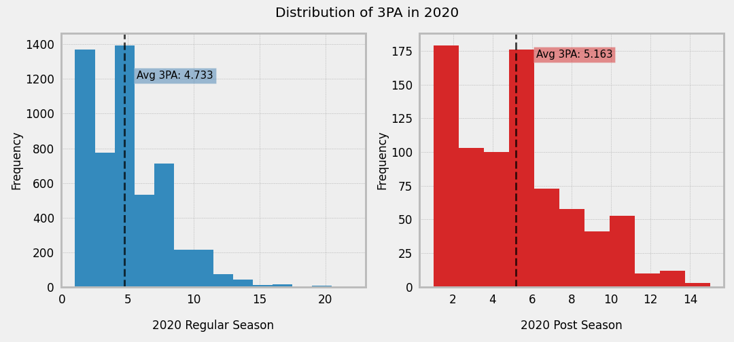
Appendix 3: 3PA in Regular Season vs Post Season

Slide 11
2020 Regular Season to Playoffs:
FG: Ttest_indResult(statistic=-1.253481926401538, pvalue=0.21031100971266276)
FGA: Ttest_indResult(statistic=-1.9707443116438985, pvalue=0.04901339706931795)
FG%: Ttest_indResult(statistic=1.5154107288489775, pvalue=0.12996004467384129)
FT: Ttest_indResult(statistic=-2.3950512166412063, pvalue=0.016792816904195373)
FTA: Ttest_indResult(statistic=-2.3191840624889526, pvalue=0.020576906738208556)
FT%: Ttest_indResult(statistic=-0.33220002652421743, pvalue=0.7398023768964648)
3P: Ttest_indResult(statistic=-1.9112116672298436, pvalue=0.056247773360592834)
3PA: Ttest_indResult(statistic=-3.785169144133143, pvalue=0.00016228807865285548)
3P%: Ttest_indResult(statistic=0.6154732663391103, pvalue=0.5383703760668487)
TSA: Ttest_indResult(statistic=-2.246850765054195, pvalue=0.024853997611800648)
TS%: Ttest_indResult(statistic=0.3291676080034232, pvalue=0.7420913687697093)
Appendix 4: T-Test p-values for Shooting Statistics from 2020 Regular Season to Playoffs

Slide 12
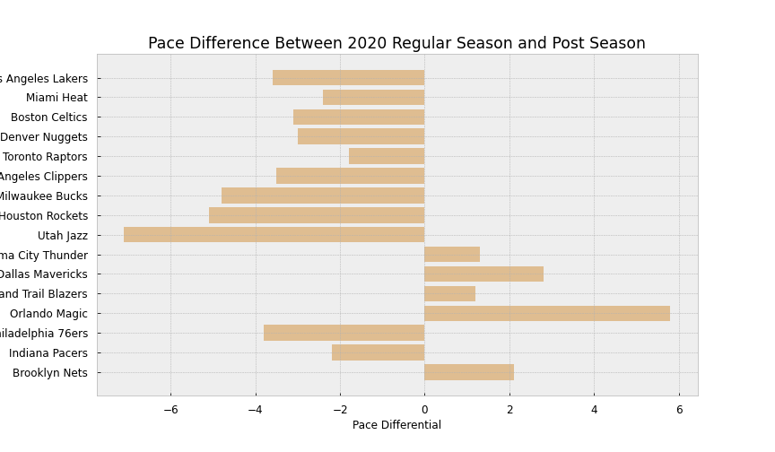
Appendix 5: Pace Differential of Playoff teams, from their Regular Season Pace to Post Season Pace

Slide 13
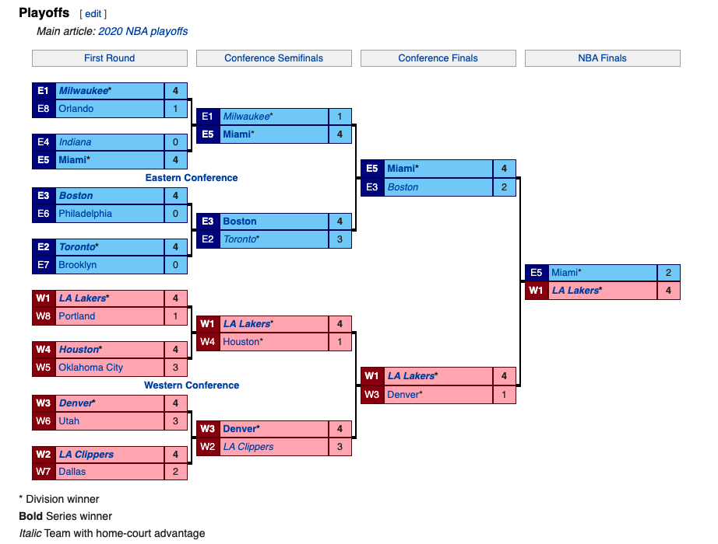
Appendix 6: 2020 Playoff Structure

